Slide 1

BROCCOLI*
the great California brassica crisis of 2015
*my least favorite vegetable and its not because I’m picky, its science. Tell your mom more here

Slide 2
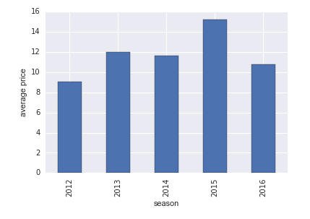
what the hell happened in 2015?
average broccoli price by season

Slide 3
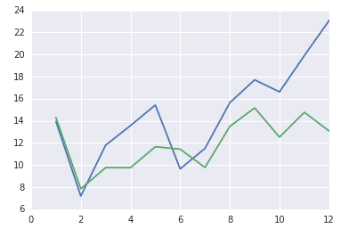
higher than average price spike in September
peak demand drove prices up
drought conditions affected crop harvest and planting earlier in the season
affected all brassicas (cauliflower, broccoli, romanesco)
Average Price
Month
2015
2011-2016

Slide 4
contract structures for produce
pay market price
contract
we pay x$ a pound, no matter what, for the agreed upon time frame
farmers don’t love this for obvious reasons
contract plus
contract plus a percentage if market value goes above an agreed upon amount
example: we agree to pay $12 a pound unless the price goes above $15, then we’ll add a dollar to our base price for every dollar the market raises (if market is $18, we would then be paying $15)
where do you set the trigger?

Slide 5
THE DATA
brought to you by the United States Department of Agriculture

Slide 6
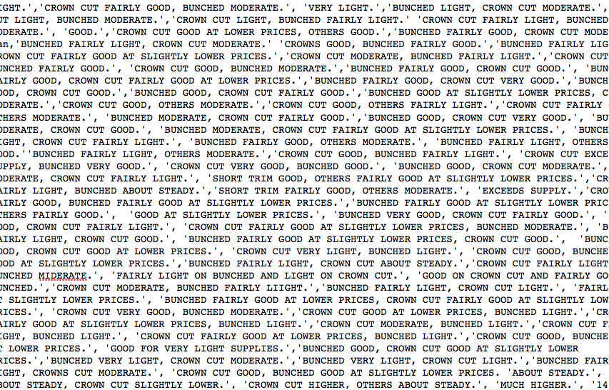
8744 rows
organized by date and sale point 2012-2015 (drought years)
city (in CA)
package (case size)
variety (crown cut or bunch)
date
low price
high price
mostly low price
mostly high price
season (year)
demand tone
market tone
comment
32 columns total with a lot of nulls and empty columns
market and demand tones were entered as strings with typos and no formatting

Slide 7
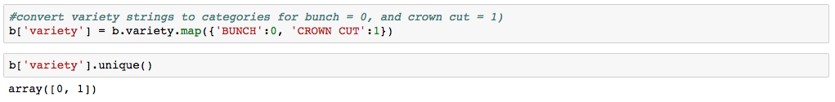
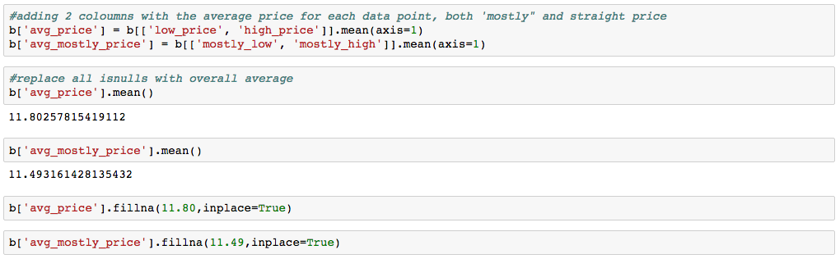
cleaning the data
standardize the varieties and turn into integers
create an average price column and an average mostly column (just in case)
standardized and shorten the column names, drop empty columns, fill nulls with averages, added a month column

Slide 8
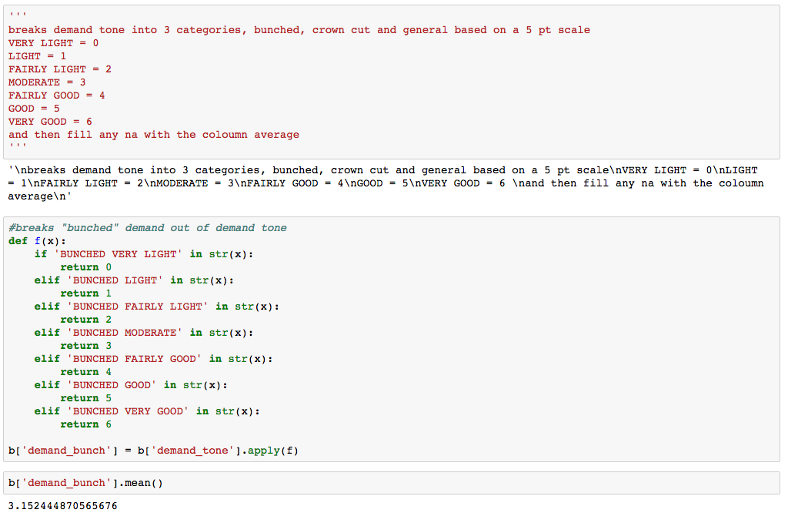
cleaning the data
market and demand tone, the messiest bits
not standardized, entered by hand (with typos), strings, with an unintuitive hierarchy structure (is fairly light, better than moderate or mostly moderate?

Slide 9
BROCCOLI PRICES PREDICTED
(ish)

Slide 10
models: trees, lines and buckets
3 machine learning models
decision tree (rmse 4.69, null accuracy 2%, 3 splits)
curious what a random forest would look like with more splits and more options to work through the noise
linear regression (27% accurate, null accuracy 2%)
too difficult to predict the price exactly
this was a little heartbreaking
logistic regression (60% accurate, null accuracy 52%)
split it into 5 price buckets to predict
worked much better but the range was still very high

Slide 11
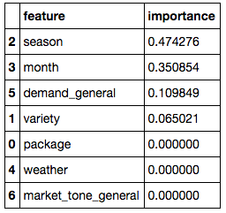
surprises
correlations were not what I expected
high correlation between season and month were not surprising
low correlation between market tone and weather
possible data integrity issue?

Slide 12
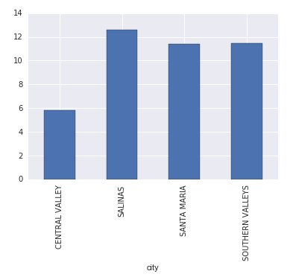
surprises
low linear regression score
high variation by location

Slide 13
challenges
data cleaning was the largest challenge
finding a model that worked well
choosing the best parameter was more challenging than I thought it would be
integrity and scope of the initial dataset
first time I worked with data too big to look at the whole thing reasonably for patterns before I started, had to rely on the machine learning models

Slide 14
$18.77
projected price of broccoli in September 2016

